Slide 1
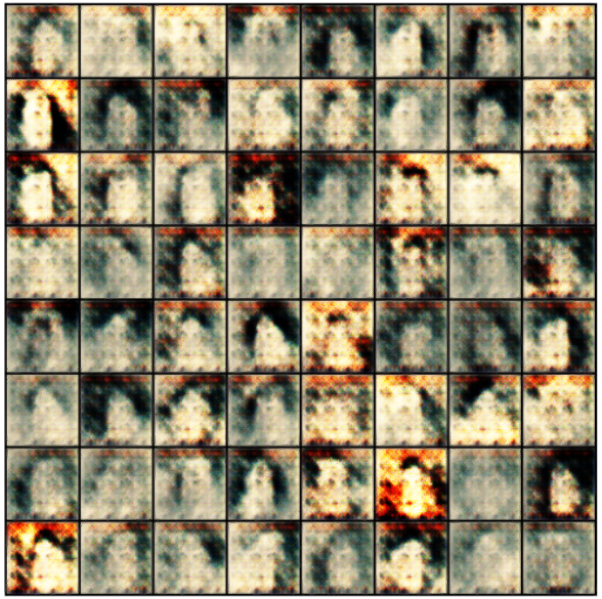
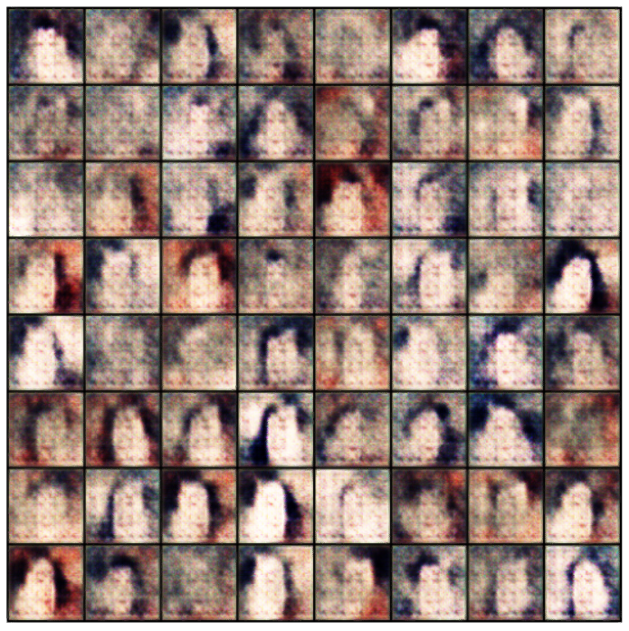
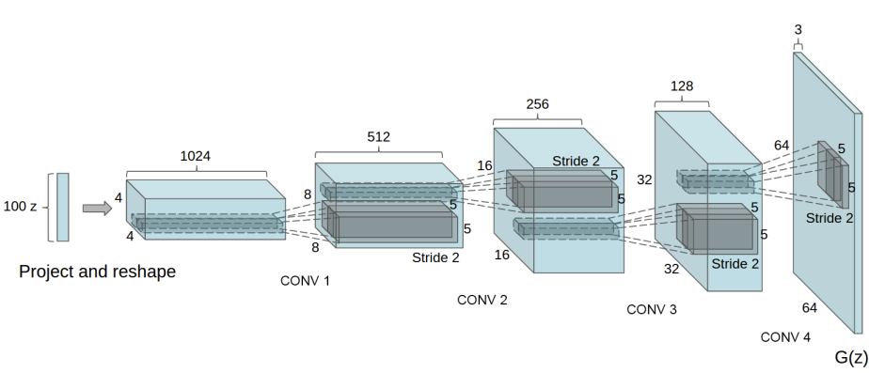
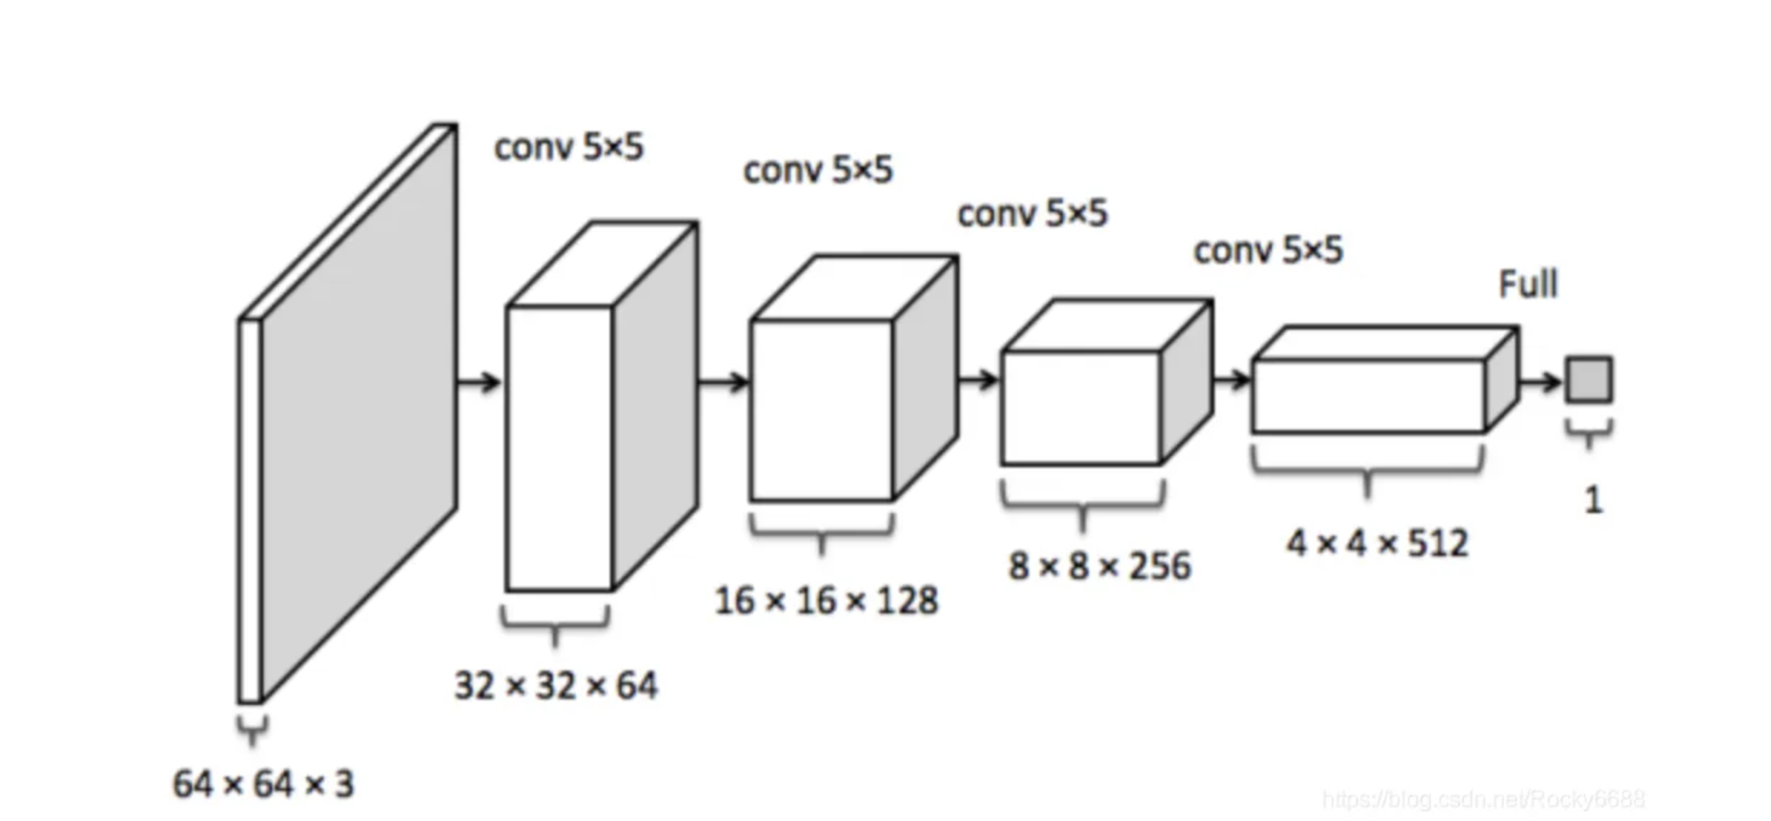
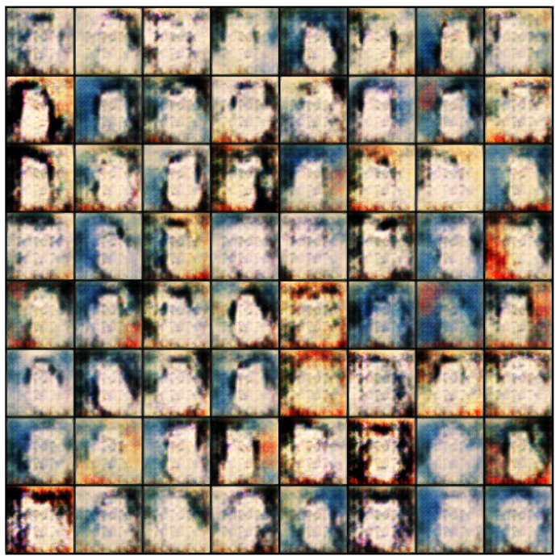
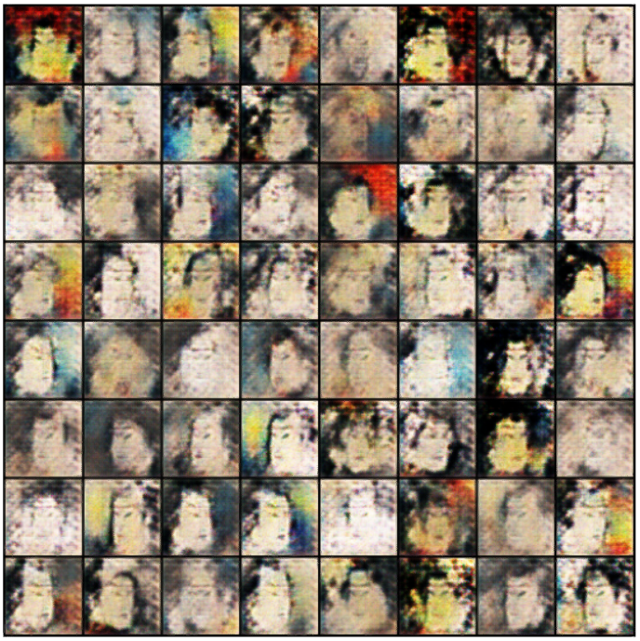
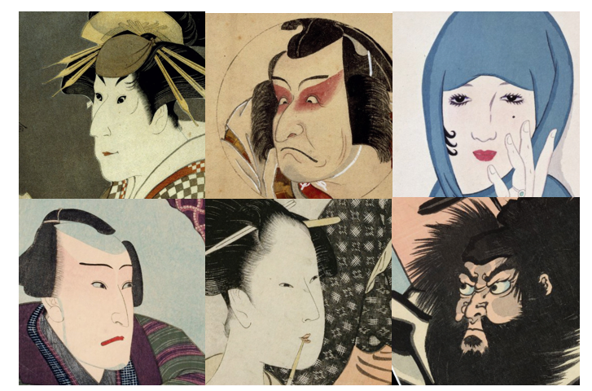
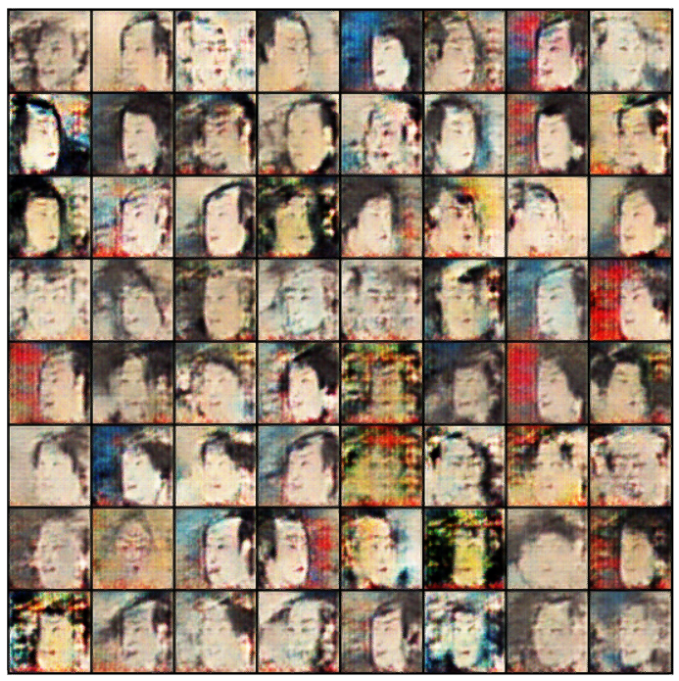
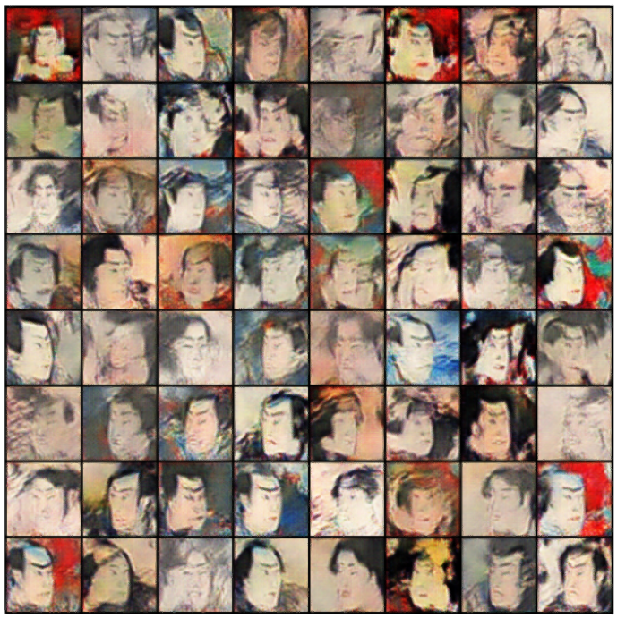
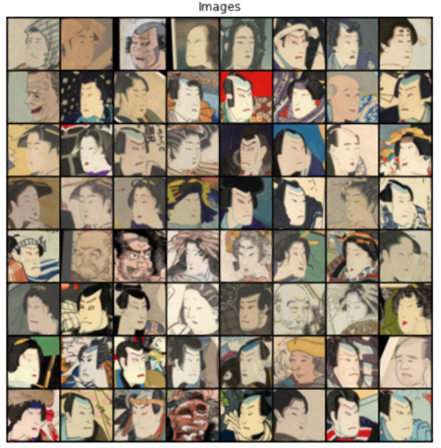
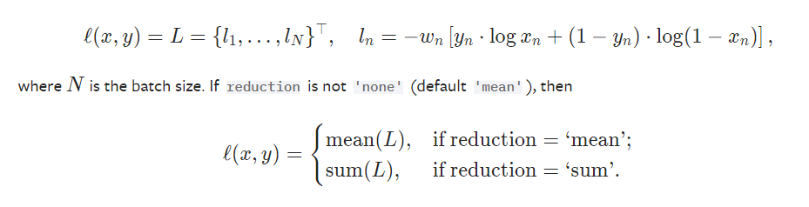
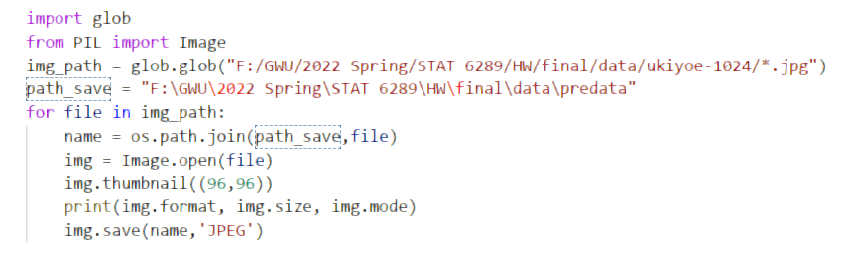
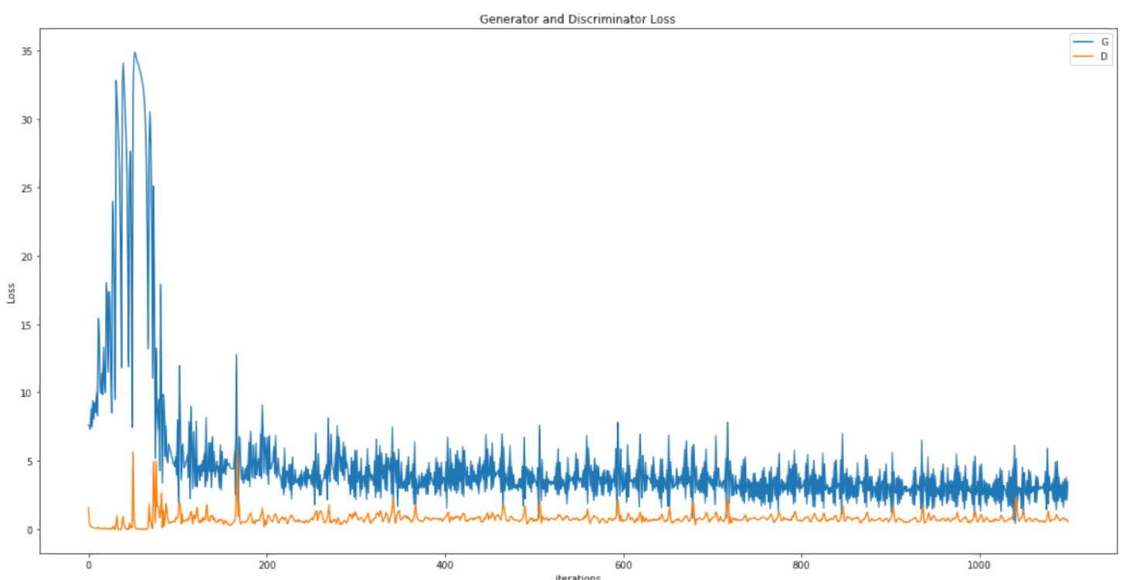
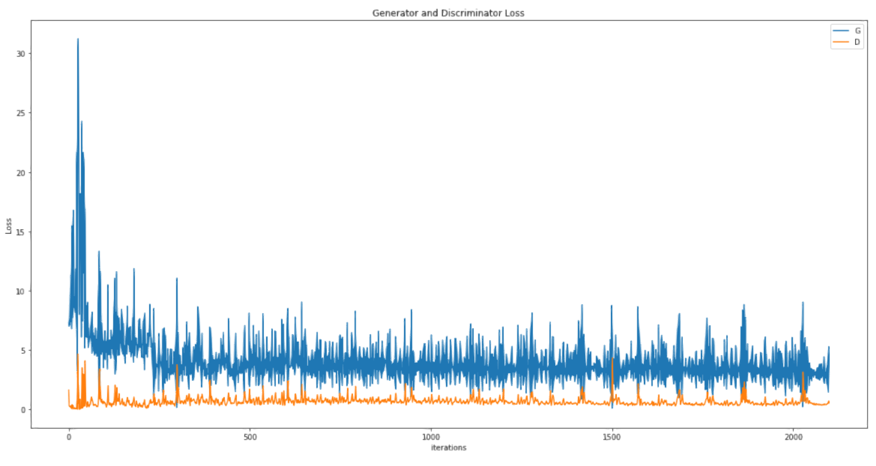
Ukiyo-e Style Generator Based on DCGAN
Hang Wang, Yi Nie
George Washington University
Introduction
DCGAN
Generator Results
This model is base on DCGAN, which changes several parameters.
In this project we verify the DCGAN effects through generating ukiyo-e images.
DCGAN is actually a modified version of GAN.
Batch size = 512 Batch size = 256
For Generator:
· No pooling layer.
· Usel deconvelusion ayers for sampling.
· Batch normalization.
· No full-connected layer.
· Use ReLu function as activate function. (tahn function in the output layer. )
For Discriminator:
· No pooling layer.
· Replace pooling with the convolution added stride.
· Batch normalization.
· No full-connected layer.
· Use LeakyReLu function as activate function.
Data preprocessing
In the dataset, there are 5209 real ukiyo-e pictures with size of 1024×1024.
When collecting the dataset, the noses of all the characters are in the center.
In order to reduce the time consumption, we batch process the size of 5209 pictures to 96×96.
econvelusion
For generator part, we change the in-channel size in first deconvolution part from 1024 to 512, compared with original paper. The kernel size chooses 4*4 in all deconvolution steps rather than 5*5. After 5 deconvolution, we use Tanh as activate function.
Discriminator of DCGAN is almost the same as a reverse of Generator part. The most different part is the activate function which used relu and sigmoid.
Binary Cross Entropy Loss Function
Just as the former loss function plots, the model trained with batch size = 256 has better generating results.
What we have learned?
Use Pillow packages to import or batch process pictures with .jpg type. We learned to batch process 5209 pictures into size that our computers are able to handle.
The concept of Transposed Convolution (Deconvolution). This is a new concept for based on convolution.
Implementation of Generative Adversarial Network(GANs). Finally we generate our own ukiyo-e pictures.
Various implementations of GANs, though it doesn’t present in our projects.
We have set batch size equals 512 and 256, then draw the loss during training process as the iteration increases.
Compared with former plots, we find the loss of model with batch size = 256 is lower.

